Slide 1












PowerShell Gems for the DBA
Rob Risetto DBInsight Technical Director
rob@dbinsight.com.au www.dbinsight.com.au (Consulting)
www.sqlrds.com (SQL Monitoring)

Slide 2



Housekeeping
Mobile Phones
please set to “stun” during sessions
Evaluations
complete online to assist session speakers
Wifi Details
Login: TBA Password: TBA

Slide 3
Who Am I
Technical Director and Principal Consultant for DBInsight.
23 years experience in DBMS, 16 years in SQL Server.
Rob Risetto www.dbinsight.com.au (Consulting Services)
0417 322 000 www.sqlrds.com (Monitoring Services)
rob@dbinsight.com.au
3 |

Slide 4
Session Today
Not a PowerPoint session
Session based on PS code snippets and demos
Highlight useful PS techniques for the DBA
Useful building blocks/ideas for your SQL automation
DBA insights along the way
4 |

Slide 5
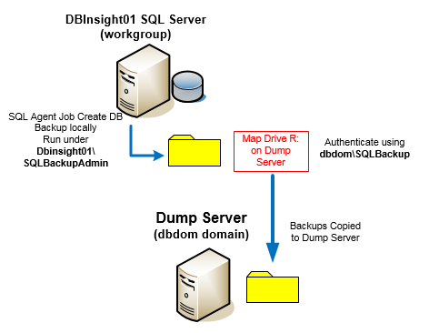
Copy Backup Topology
5 |

Slide 6
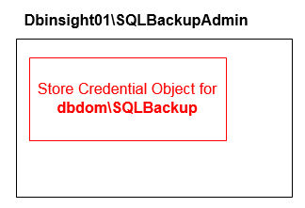
Credentials in PowerShell
6 |

Slide 7
PowerShell GUI
Why a GUI in PS
System Admin doesn’t have to know C#/Java
All code is in PowerShell – easier to maintain
Transportable – using Windows Form or .Net
Allow easier entry of parameters, with validation
Better display of system info/output
Free PS GUI Designer Tool - Admin Script Editor
http://www.itninja.com/community/admin-script-editor
7 |

Slide 8
Contact Me
Rob Risetto www.dbinsight.com.au (Consulting Services)
0417 322 000 www.sqlrds.com (Monitoring Services)
rob@dbinsight.com.au

Slide 9

Questions?
Please make sure you visit and thank our fantastic sponsors:
Gold Sponsors
Bronze Sponsors
Silver Sponsors
Swag Sponsors

